Slide 1
CS3244
GROUP 40
DEEPWEEDS
Cheong Yee Ming
Yeluri Ketan
Kong Fanji
Cheah Yan (Xie Yan)
Bryan Tee Pak Hong
Notes:
Cheah Yan

Slide 2
CONTENT
01
Dataset
04
Non-Linear Models
DeepWeeds
Convolutional Neural Networks (CNN),
Transfer Learning
02
Data Preprocessing
Evaluation of Models
05
Preparation of data for smoother operations
Elaboration on performance of models
03
Linear Models
06
Conclusion
KNN, Decision Trees, SVM and Logistic Regression
Overall best model in categorizing DeepWeeds
Notes:
Cheah Yan

Slide 3
Dataset Introduction
Consists of 17509 images
Capturing 8 weed species native in Queensland Australia
Imbalanced data as negative classes outnumber other classes significantly
Different weed classes have minimal differences
Notes:
Cheah Yan

Slide 4
Motivation
Why Deepweed?
Reduces Chances of Human Error
01
02
Reduce Human Labour
03
Prevent Possible Infestation of Weeds

Slide 5
Data Preprocessing
Colour Histograms
RGB 3D histograms
Overview
Edge Detection
Identify important edges and boundaries of different weeds
Resizing
Decrease number of dimensions
HSV masking
Remove background noise of other vegetation
Undersampling
Improve dataset imbalance
Notes:
Clement
Here’s an overview of the few data pre-processing methods we looked into in order to prepare the data for training. The pre processing methods aims to improve the dataset before it gets passed into our linear models in hopes that the way we extract useful features can give our models good results.

Slide 6
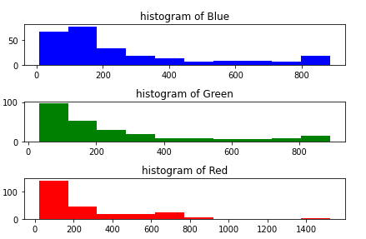
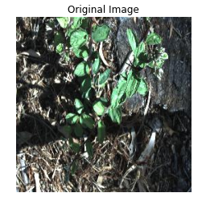
Colour Histograms
Notes:
Clement
The original image consists of values from the 3 RGB channels. The image is first converted from RGB to HSV color space before constructing a 3D HSV color histogram.

Slide 7
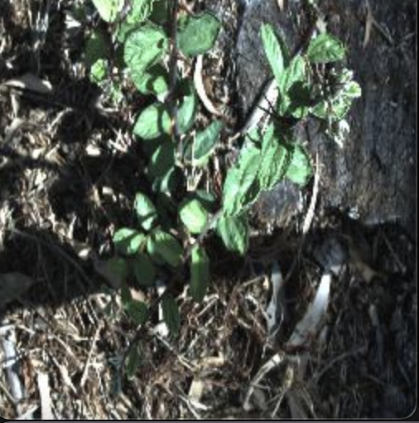
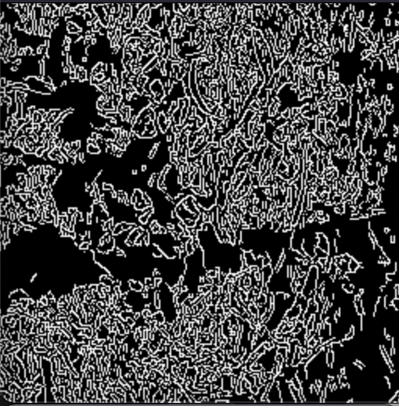
Edge Detection
Original
Rationale for usage:
Difficult to differentiate weeds through colours
Weeds might have unique edges and shapes to classify them by
Implementation and findings:
Significant noise identified due to background vegetation
Required other methods to ensure less noise
Canny Edge detection
Notes:
Clement
Next we looked at edge detection, in particular, Canny edge detection, as it is said to remove noise from image by smoothening, then prioritise regions with high spatial derivatives. Weeds were hard to differentiate through colours, and we hoped that unique edges would help identify the different weeds and improve the model accuracy.
The reality was that Canny edge detection failed to remove a lot of noise in the background, and background vegetation was mistaken for parts of the weed as well.

Slide 8
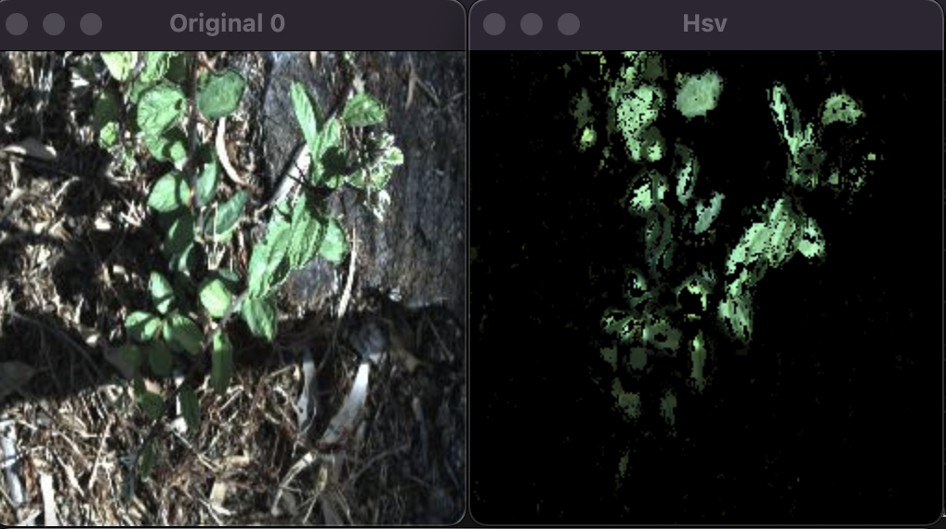
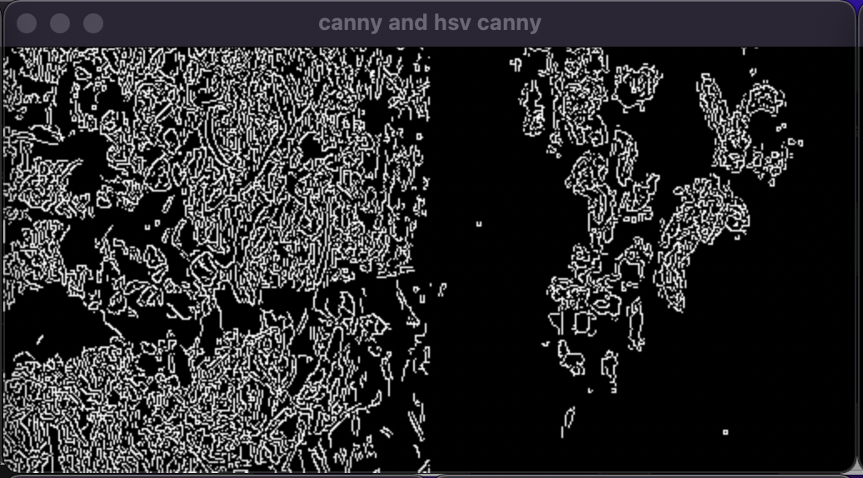
HSV masking
Clement
Original and HSV masked
Rationale for usage:
Mask the important features through HSV mapping
Remove noise due to background vegetation
Implementation and findings:
Results were still not satisfactory (based on logistic regression)
Poor results due to high dimensionality of features and possible loss in information
Canny on original vs Canny on HSV masked
Notes:
Clement
We then came up with another idea to map the RGB values to HSV, and do some masking to filter out background noise ourselves. We found no improvements to the model, and thought that manual removal of noise could cause more harm than good since important information could have been removed despite removing background noise.

Slide 9
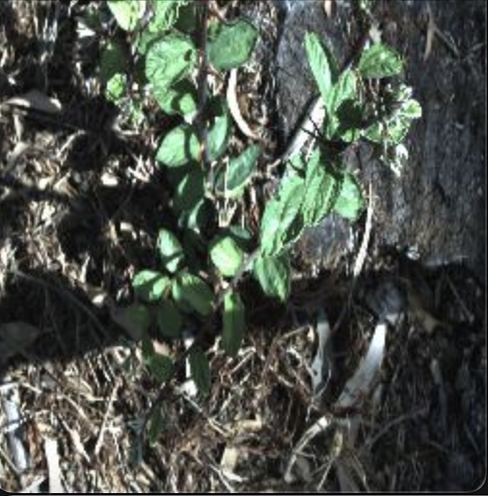
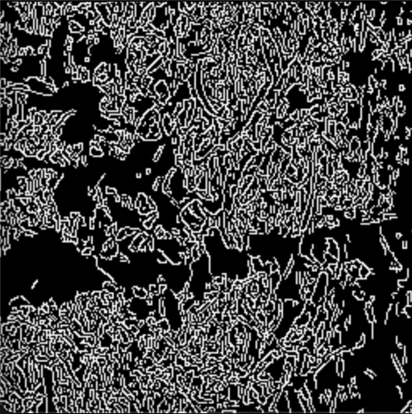
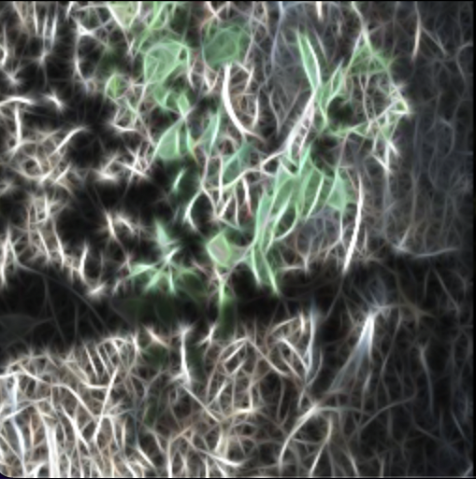
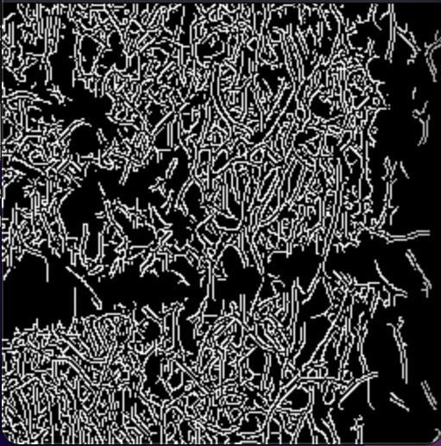
Gabor filters
Original and Canny
Rationale for usage:
Extract important textures and features from the images
Could be better than HSV masking as it does not accidentally remove important features
Implementation and findings:
Also see a small improvement in findings
Poor results due to high dimensionality of features and possible loss in information
Require other preprocessing methods to improve results
Gabor and Canny
Notes:
Clement
From there, we decided to use Gabor filters, which aimed to extract important textures and features from the images, then pass it into canny to get a single channel for training. This does not accidentally remove features like HSV masking does. We found that there was small improvements in findings, and speculate that Gabor filters themselves help to filter out noise and emphasise on important features itself.
However, results are still poor and we conclude we require other preprocessing methods to improve results, such as reduction in dimensionality etc.

Slide 10
Comparisons
Image w/ Canny | Test
Original | 0.488
HSV masking | 0.347
Gabor filter | 0.490
Notes:
Clement
Looking at this comparison table, we believe HSV masking performed poorly due to excessive removal of features that could be important. The poor results overall is could be improved by tackling unbalanced classes and high dimensionality issues, and we aimed to try other preprocessing methods to counter this next.

Slide 11
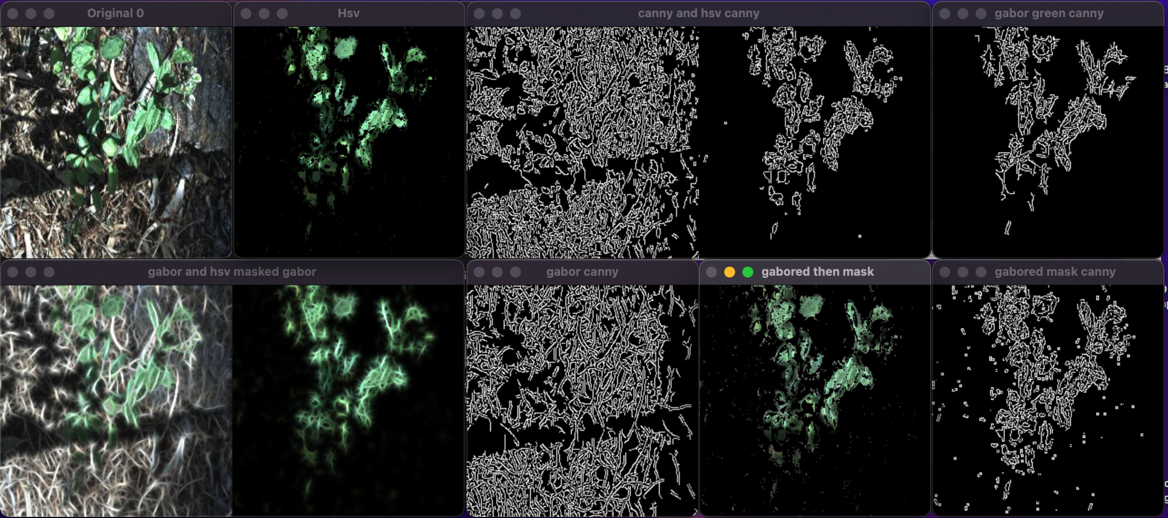
Further experimentation
Further experimentations showed insignificant improvements in predictions
Other pre-processing methods required
Notes:
Clement
Further experimentations with gabor filters, canny edge detection and hsv masking also showed minimal improvements.

Slide 12
Resize Images
Input Images
Dimensions: 256 x 256
cv2.INTER_AREA - Uses pixel area relation
- Resized images have dimensions that are factors of the original
cv2.INTER_AREA
cv2.INTER_CUBIC
Library: OpenCV (cv2)
cv2.INTER_LINEAR
cv2.INTER_NEAREST
Output Images
Dimensions: 32 x 32, 64 x 64, and 128 x 128
Notes:
Resizing images is a critical data preprocessing step as it reduces training time and allows for faster hyperparameter tuning. The library that we used to resize our images is cv2 or also known as OpenCV which offers a couple of different interpolation options each of them having their unique properties for image scalling. In our case, we used the INTER_AREA for resizing since this interpolation option uses pixel area relations. This allows this whole process of resizing our original images to be faster while ensuring the quality of our resized image.

Slide 13
Undersampling
Why Undersampling?
Oversampling reuses images, with minimal features learnt
Negative classes do not really have features to learn and if undersampled, will not lose as much data as we think
Notes:
The problem with the unbalanced data is that there is a huge number of negative data as compared to each individual class.
We chose to undersample in order to balance this out, due to the fact that oversampling might reuse images and have minimal additional features learnt.
We also believe that negative classes do not really have features to learn and if we do undersample, we will not lose as much data as we think we would.
The undersampling is used in conjunction with resizing to compare between the different linear models to check the effectiveness of them. This will be shown later on.

Slide 14
Naive models (Macro Average)
Undersampled dataset, resized to 64x64 and directly train them
Models | Precision | Recall | F1-Score
K-nearest neighbours | 0.08 | 0.11 | 0.09
Decision trees | 0.19 | 0.19 | 0.19
SVM | 0.11 | 0.11 | 0.11
Logistic Regression | 0.10 | 0.10 | 0.10
Notes:
These are the macro average scores for the different models. Comparing the models we can see that Decision trees gave the best out of all the linear models and by quite a huge margin. This could be because that decision trees supports non-linearity and that they are better able to model the non-linear target function of this image classification task

Slide 15
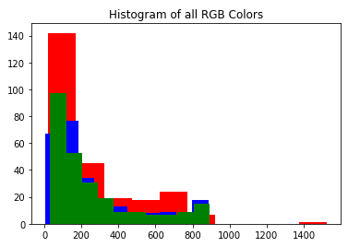
k-Nearest Neighbours (kNN)
Raw Pixel Intensities
01
Accuracy: 52.46%
Optimal k: 16
Metric: Chebyshev
Features Extracted
02
Colour Histograms
Accuracy: 68.05%
Optimal k: 6
Metric: Manhattan
Canny Edge Detection
03
Accuracy: 52.43%
Optimal k: 92 / 92 / 14
Metric: Euclidean / Manhattan/ Chebyshev
Notes:
After hyperparameter tuning with knn we were able to obtain the highest accuracy of 66.82%.
In all cases, we were able to obtain > 50% accuracy, demonstrating there is an underlying pattern to the images for raw pixel intensities, canny edge detection, and color histograms.

Slide 16
Decision Trees Hyperparameters
criterion
splitter
max depth
min sample split
Split quality
Split strategy
Depth of tree
How many samples in a split?
1. Gini
2. Entropy
3. log_loss
1. Best
2. Random
None or < min sample split
Default = 2
Random state
min impurity decrease
These parameters have little to no effect on our dataset!
Fix randomness
Impurity of nodes
By default completely random
If exceed this value, split node further
Notes:
Conceptually, Decision Tree draws if/else boundaries on pixels. Even if Decision Tree is non-linear, semantically the boundaries are hard coded and do not mean anything.
While these parameters shown on the slide for decision trees are powerful, our f1-score varied minimally and didn’t have much effect on the dataset.
We then thought of it the other way: perhaps we could use this as reference, and tune the other models to match the performance of Decision Tree?

Slide 17
Support Vector Machine (SVM)
Kernel
C
Gamma
Transforms the input into a higher-dimensional space
Useful to separate data non-linearly
Penalty parameter
Determines how big of a margin the SVM has
The higher the C, the smaller the margin
Defines how far the influence of a single training example affects the decision boundary
With low meaning “far” and high values meaning “near”

Slide 18
Optimal Hyperparameter values for SVM
Kernel | C | Gamma | Accuracy(%)
polynomial | 1 | 0.001 | 68.24
01
02
03
Gamma
Kernel
C
This selection of Gamma value is ideal to capture the complexity of the data
Dataset is probably not linearly separable, hence the need for transformation to a polynomial kernel to better fit the data
There is substantial amount of noise in the images of the dataset. We were able to derive a suitable penalty parameter at 1 to handle error in our SVM

Slide 19
Naive models (Macro Average)
Undersampled dataset, resized to 64x64 with Hyperparameter Tuning
Models | Precision | Recall | F1-Score
K-nearest neighbours | 0.16 | 0.17 | 0.16
Decision trees | 0.19 | 0.19 | 0.19
SVM | 0.11 | 0.11 | 0.11
Logistic Regression* | 0.10 | 0.10 | 0.10
Notes:
These are the macro average scores for the different models after hyperparameter tuning. Comparing the models we can see that Decision trees still gave the best scores out of all the linear models.
We did not tune the logistic regression model as we felt that there were no critical hyperparameters that could largely influence the improvement of a logistic regression model as compared to SVM and knn.

Slide 20
Naive Models Observation
01
Models were inaccurate
Features extracted
02
Observations
Naive models could not break the 70% accuracy mark even with hyperparameter tuning being done.
Minor improvement to models but insufficient in making models perform well
High Bias
04
03
Unable to use all data
Original resolution makes long training time impossible.
Tend to underfit the target function as it is unable to capture the relations between features and target output
Notes:
We can see that most of the naive models were inaccurate and could barely break the 70% mark even with tuning. The features extracted were not sufficient in making the models perform well. We were not able to use all our data due to training and testing time constraints. Lastly the models had high bias and were underfitting the target function.

Slide 21
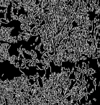
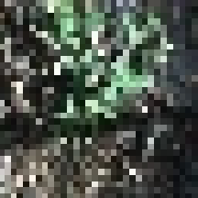
Naive Models Conclusion
The features extracted were lacking
Edge detection picked up a lot of the background (noise) and could not extract much useful information
Loss of information and details when resizing images
Other features extracted did improve the performance of these models but they are far from being optimal
Linear (Naive) Models are not competent enough
Not complex enough to model target function
We should try apply more complex models
Allow for automatic extraction of features that are actually useful in classifying the weeds
Notes:
In conclusion, after experimenting with the naive models, we could tell that the features extracted were lacking and not good enough. As seen from canny edge detection, it actually picked up most of the background as well, which did not contribute much to the usefulness of the feature extracted. Furthermore, there could be loss of important information and details when we resize images. While other features extracted such as the colour histograms did improve the performance of these models, they are far from being optimal. We can conclude that naive models are not competent enough to model a more complex target function and we should try models that are more complex such that we can allow for automatic extraction of features that are actually useful in classifying the weeds.

Slide 22
More Complex Models?
Train CNN from scratch
Transfer Learning
Convolutions, Dense layers
ResNet50

Slide 23
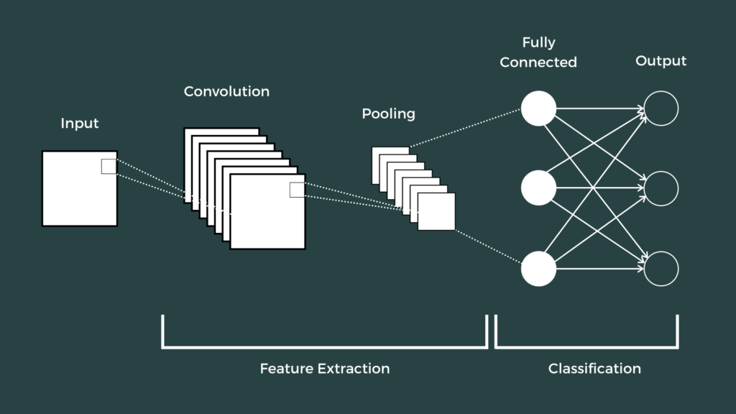
Convolutional Neural Networks
Data Split
8 : 1 : 1
Library
Tensorflow, Keras
Loss Function
Categorical Cross Entropy
Evaluation Metric
Categorical Accuracy (Detection & Classification)
Recall (Micro avg) (Classification)
8 species classes - Positive
Negative class - Negative
Visualization/Interpretation
Confusion matrices
GradCAM

Slide 24
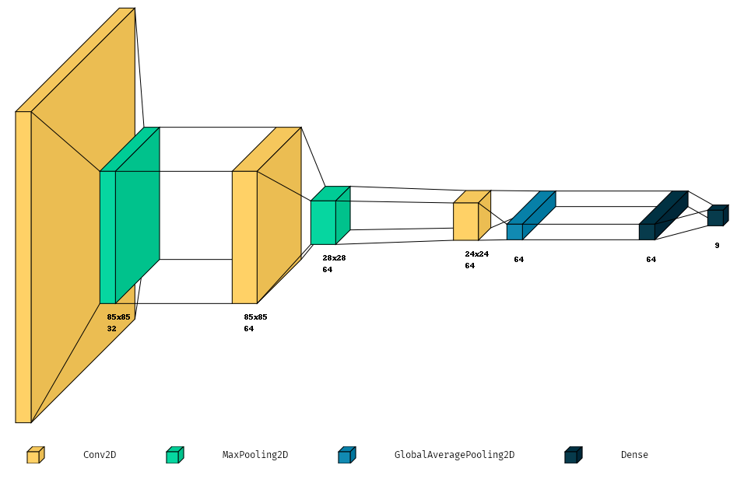
CNN - Simple
3 x (Conv - Pool) blocks
Trainable parameters: 160,905
Training Data: 14002
Validation Data: 1760

Slide 25
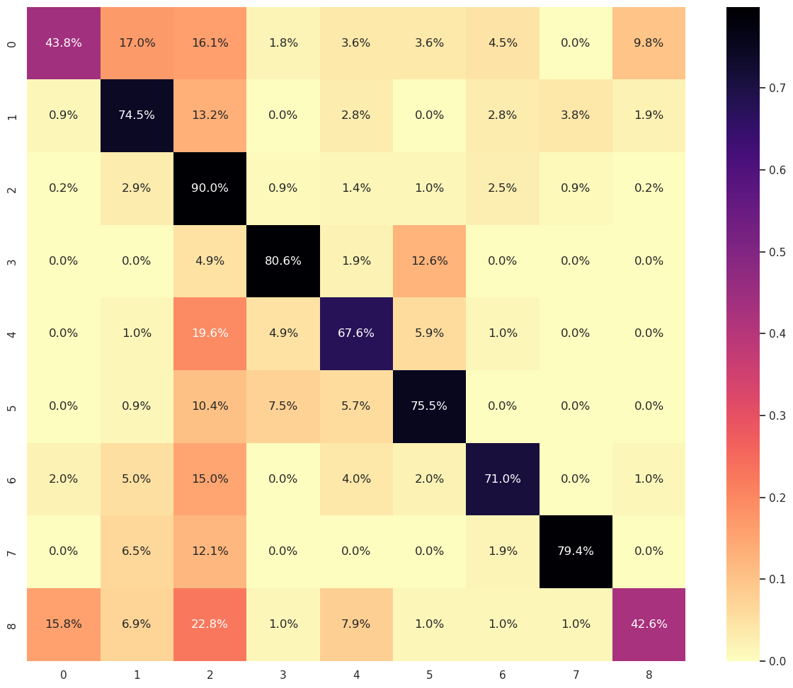
CNN - Simple
% based Confusion matrix for Validation set
Results
Train Accuracy | 89.74 %
Val Accuracy | 78.88 %
Recall (Micro) | 66.78 %
True
Predicted

Slide 26
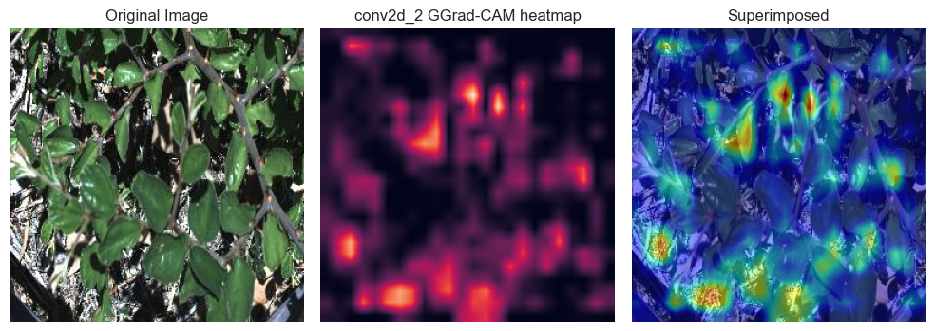
CNN - Simple
Observations
Correct Prediction
Chinese apple with 87.49 % confidence
Major Influences
Leaf shape, color, shadows, ground

Slide 27
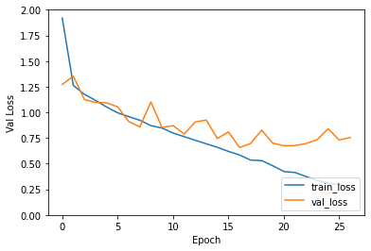
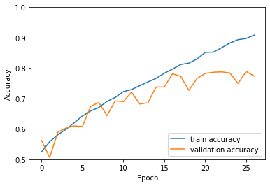
CNN - Simple
Observations
Improvement is very gradual
val_loss diverging train_loss
Kernel size too big - 5?

Slide 28
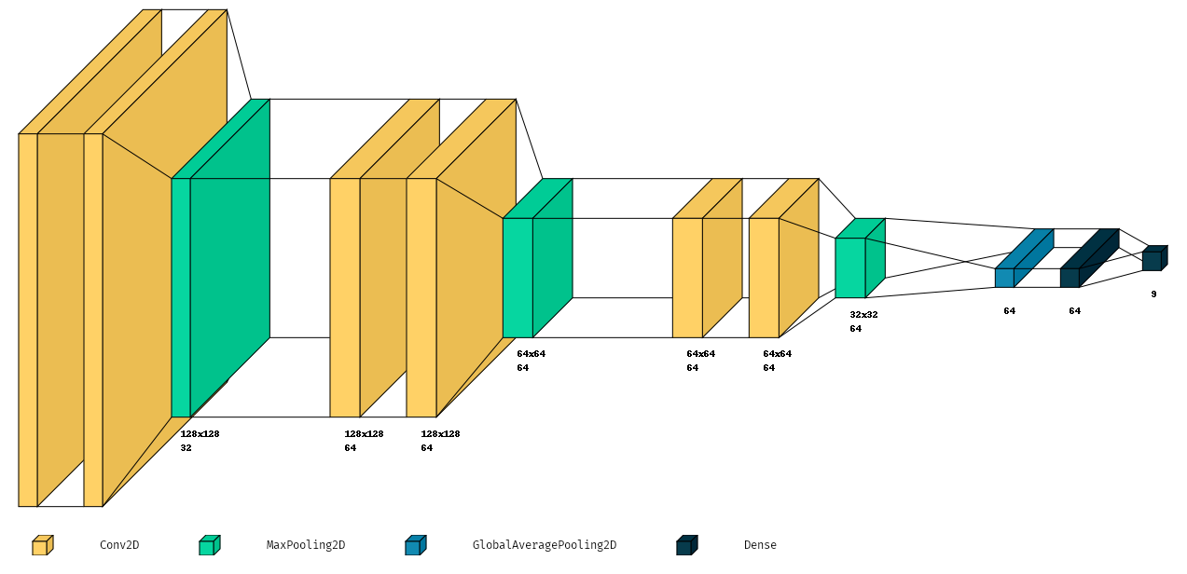
CNN - 2 - Con
3 x (Conv - Conv - Pool) blocks
Trainable parameters: 144,169
Training Data: 14002
Validation Data: 1760

Slide 29
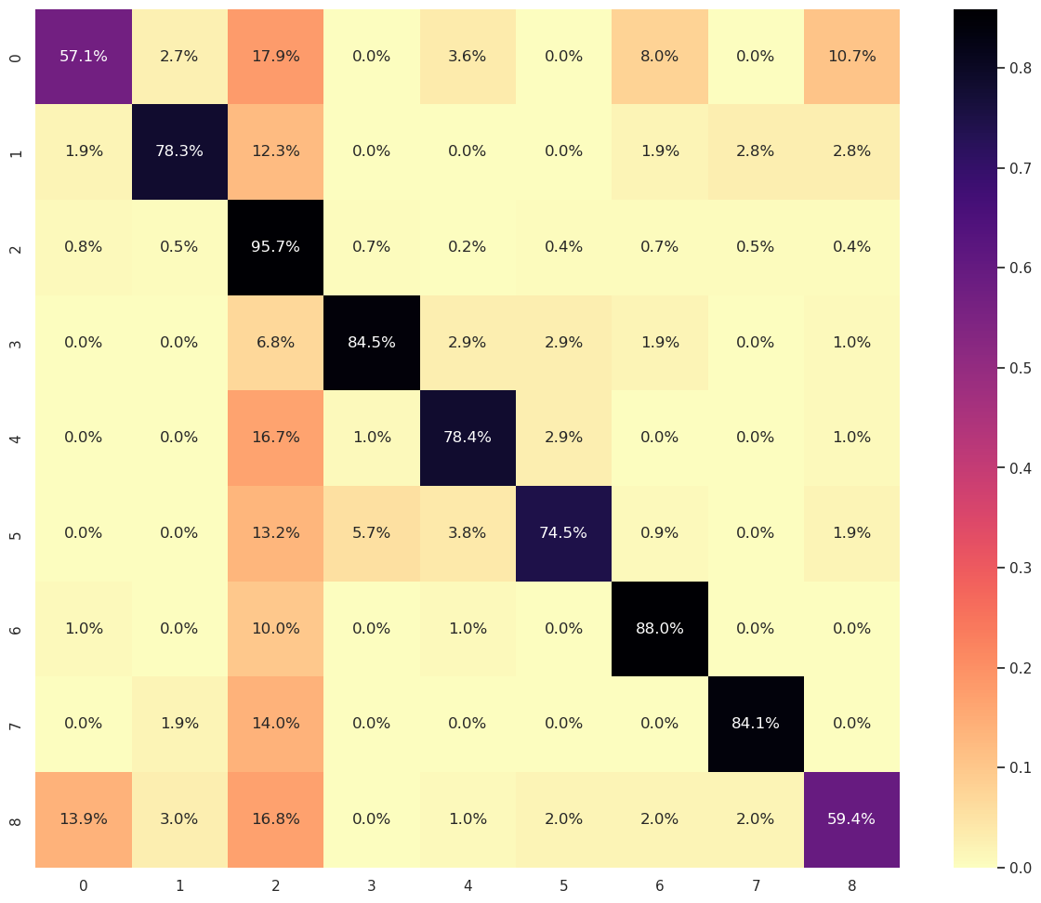
CNN - 2 - Con
% based Confusion matrix for Validation set
Results
Train Accuracy | 93.99 %
Val Accuracy | 85.98 %
Recall (Micro) | 75.38 %

Slide 30
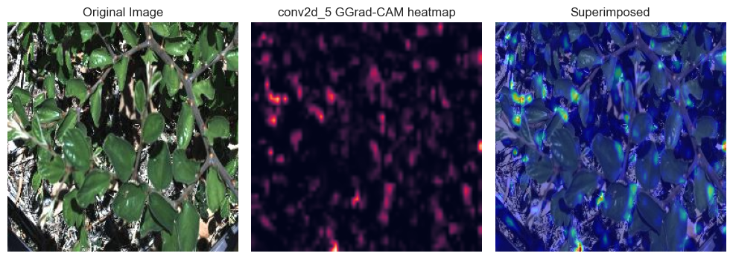
CNN - 2 - Con
Observations
Correct Prediction
Chinese apple with 97.91% confidence
Major Influences
Leaf shape, color, texture

Slide 31
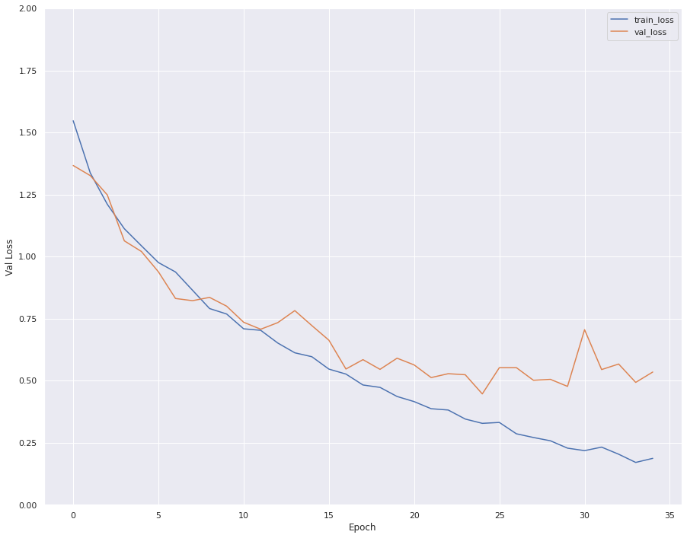
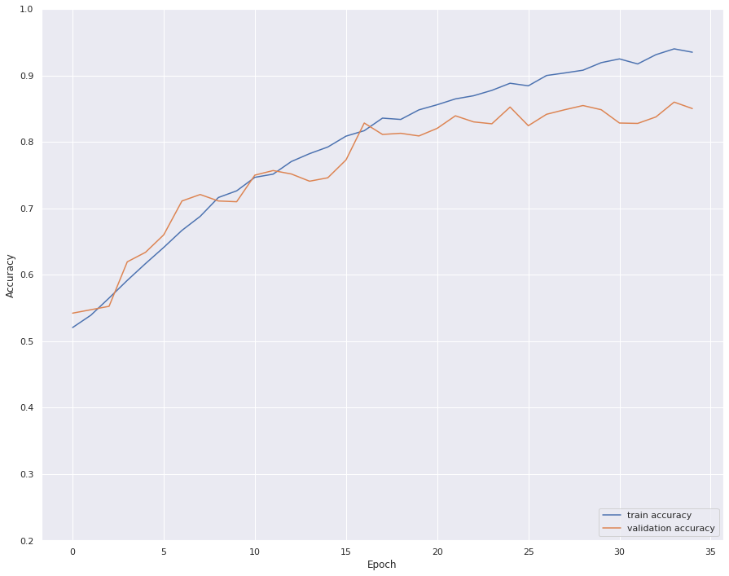
CNN - 2 - Con
Observations
Diverging losses
Overfitting persists
Introduce batch normalization?

Slide 32
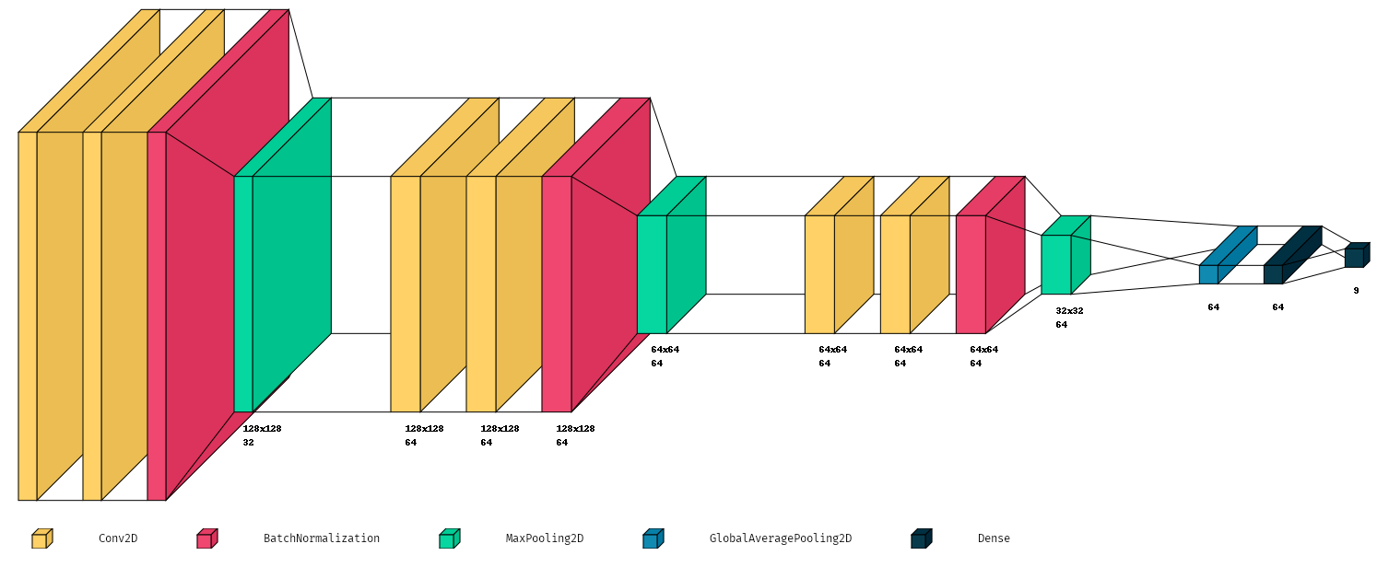
CNN - 2 - Con - BNorm
3 x (Conv - Conv - BNorm - Pool) blocks
Trainable parameters: 144,489
Training Data: 14002
Validation Data: 1760

Slide 33
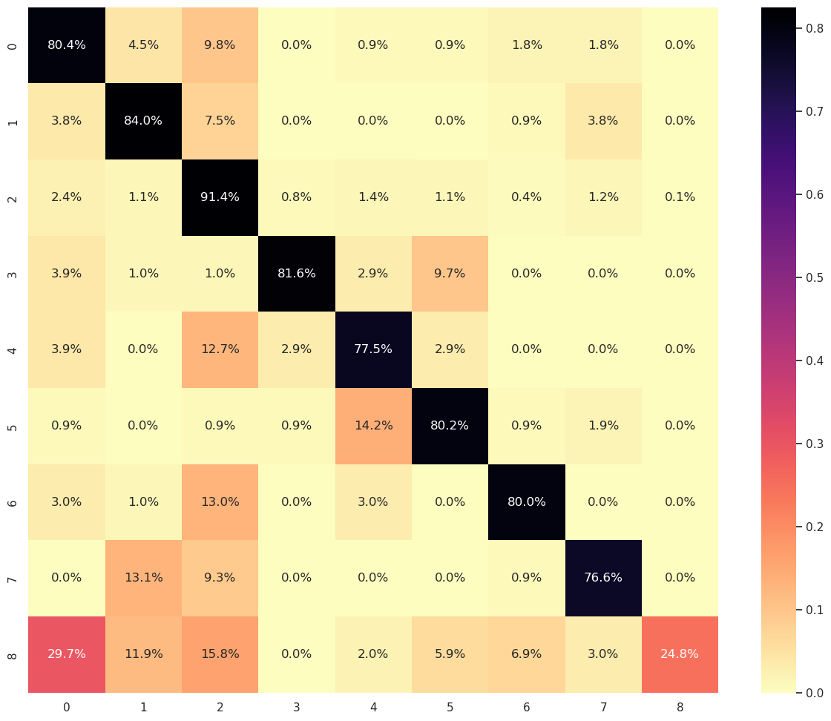
CNN - 2 - Con - BNorm
% based Confusion matrix for Validation set
Results
Train Accuracy | 92.89 %
Val Accuracy | 82.77 %
Recall (Micro) | 73.18 %

Slide 34
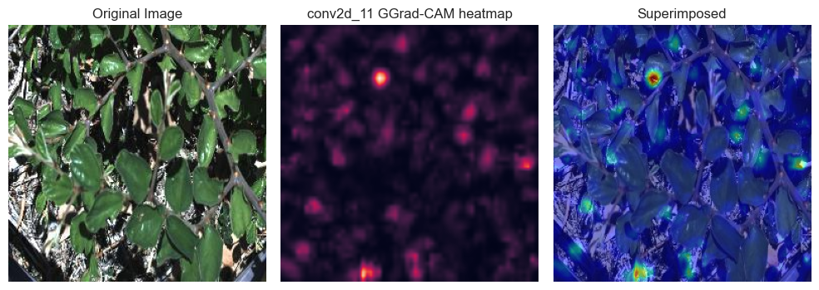
CNN - 2 - Con - BNorm
Observations
Correct Prediction
Chinese apple with 99.73% confidence
Major Influences
Leaf shape, shadows

Slide 35
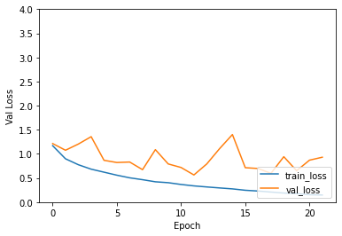
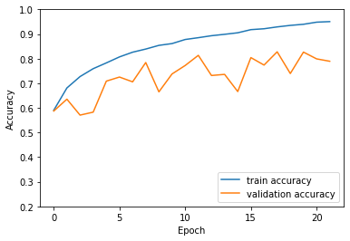
CNN - 2 - Con - BNorm
Observations
Unstable loss metrics

Slide 36
Data Augmentation
Class Imbalance
Augment weed species by 5x
1x raw data
4x randomly transformed
Random flips
Random rotation
4500 images / weed species
7200 negative images
Increase total from 14002 to 40874

Slide 37
CNN - 2 - Con - BNorm - Aug
3 x (Conv - Conv - BNorm - Pool) blocks
Trainable parameters: 144,489
Training Data: 40874
Validation Data: 5095

Slide 38
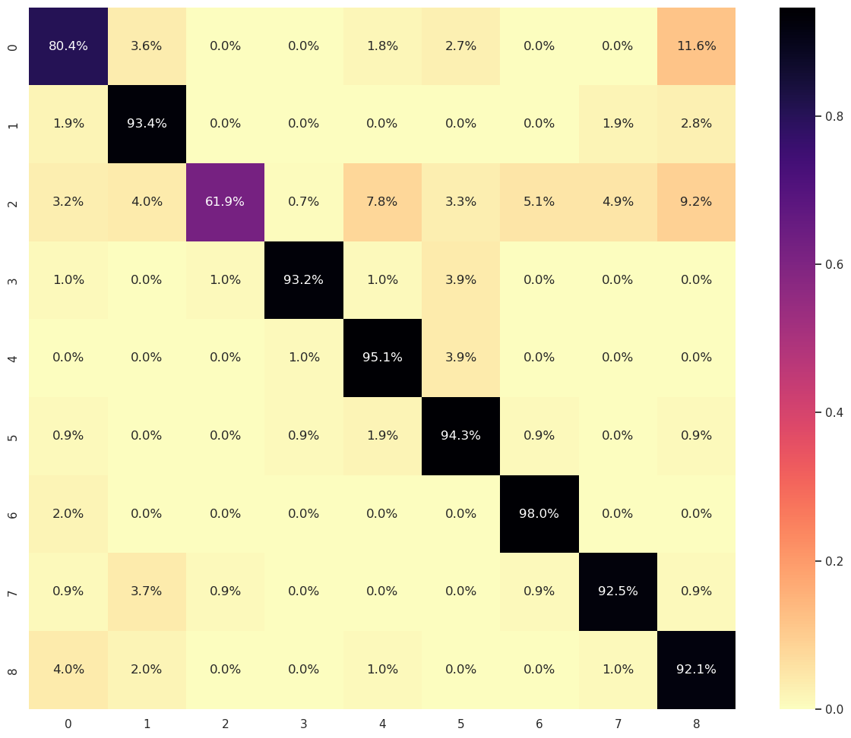
CNN - 2 - Con - BNorm - Aug
% based Confusion matrix for Validation set
Results
Train Accuracy | 97.94 %
Val Accuracy | 85.00* %
Recall (Micro) | 92.23 %
*augmented validation data

Slide 39
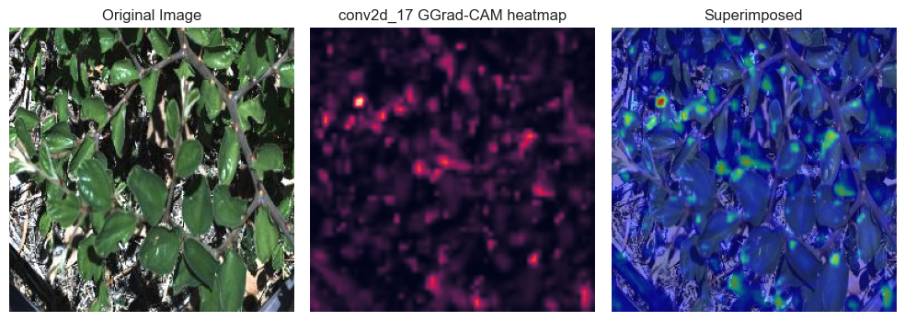
CNN - 2 - Con - BNorm - Aug
Observations
Correct Prediction
Chinese apple with 97.04% confidence
Major Influences
Leaf shape and texture

Slide 40
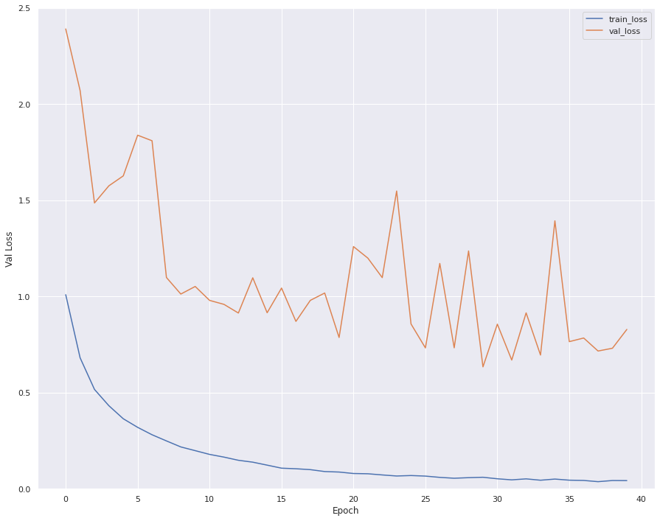
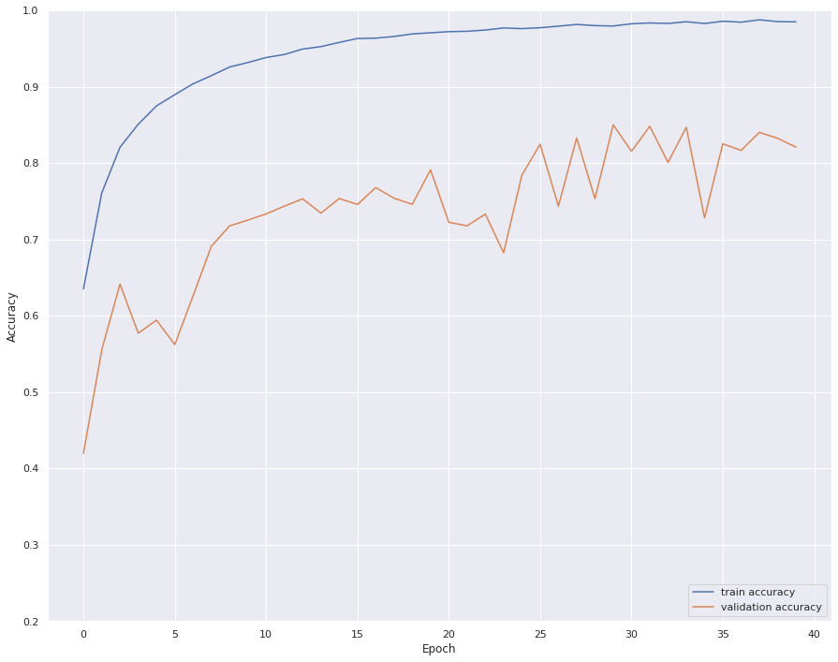
CNN - 2 - Con - BNorm - Aug
Observations
Good at classifying species
Fails at detecting negatives
Heavy oscillation

Slide 41
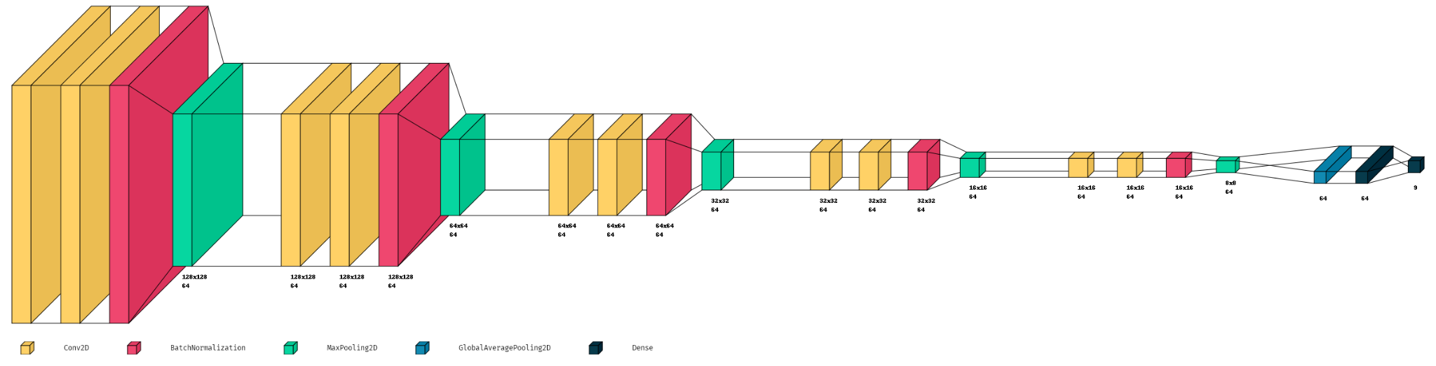
CNN - 5 - Aug
5 x (Conv - Conv - BNorm - Pool) blocks
Trainable parameters: 339,529
Training Data: 40874
Validation Data: 5095

Slide 42
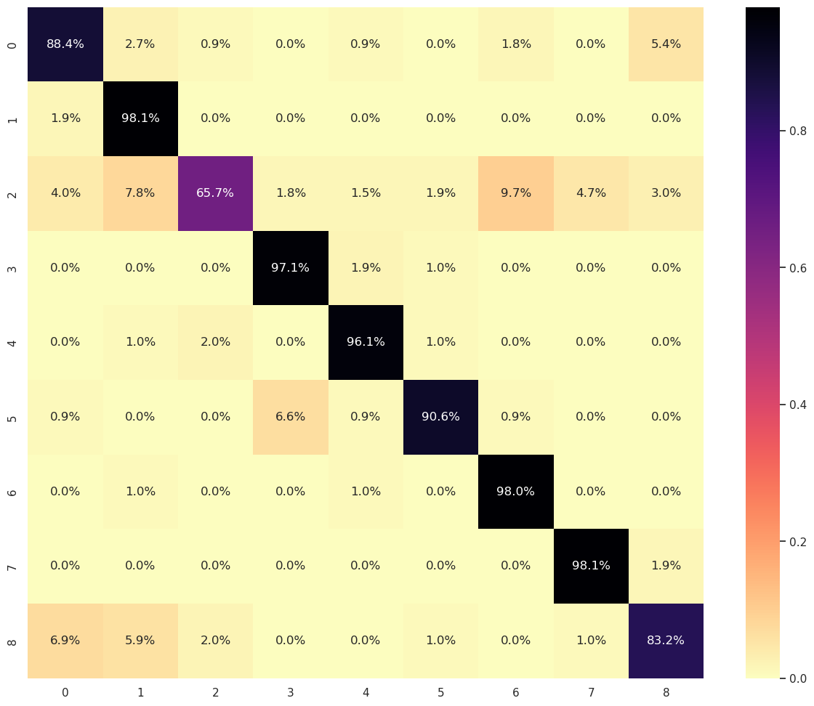
CNN - 5 - Aug
% based Confusion matrix for Validation set
Results
Train Accuracy | 99.04 %
Val Accuracy | 85.89* %
Recall (Micro) | 93.66 %
*augmented validation data

Slide 43
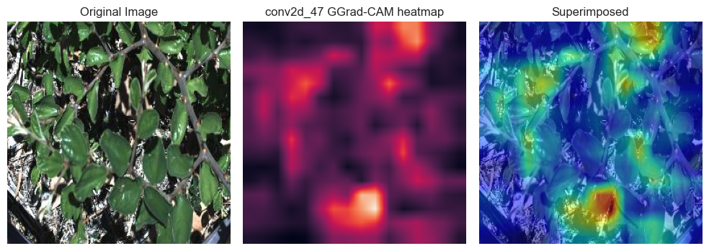
CNN - 5 - Aug
Observations
Correct Prediction
Chinese apple with 99.66% confidence
Major Influences
Leaf shape, color, texture, cluster

Slide 44
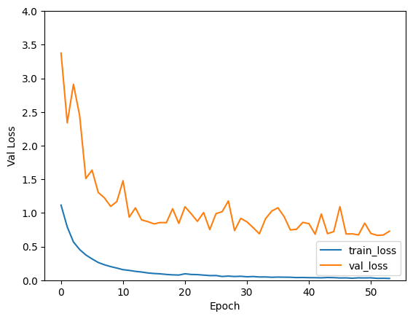
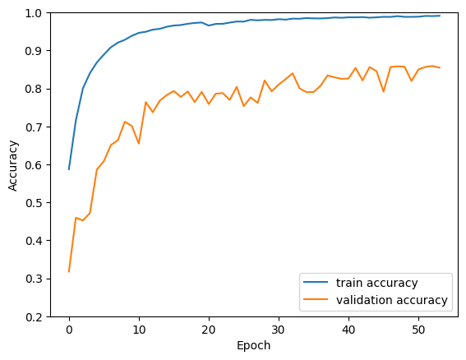
CNN - 5 - Aug
Observations
Excellent at classifying species
But unable to detect negatives accurately
Reduced oscillations

Slide 45

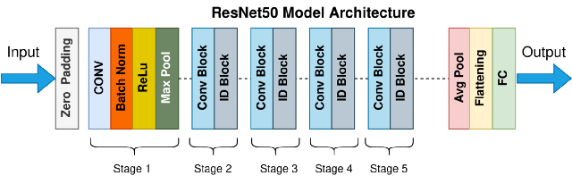

Transfer Learning
Transfer learning is a machine learning method where a model developed for a task is reused as the starting point for a model on a second task.
Custom Weed Predictor
Trained on a big image dataset so that you do not need to re-teach the model useful features! Start from where I ended!
AI Professional
Notes:
Question: Can we trust these AI Professionals? What is big dataset?
We used Imagenet pretrained weights. https://www.image-net.org/

Slide 46
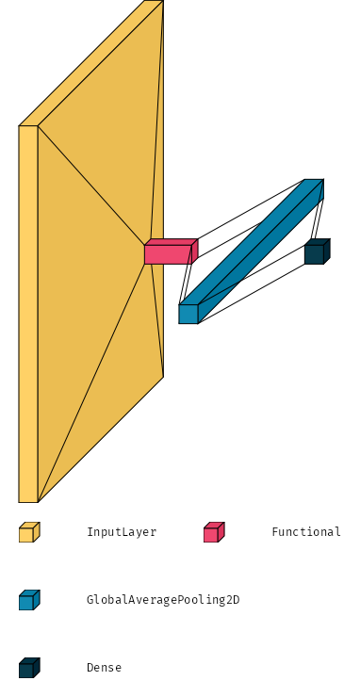
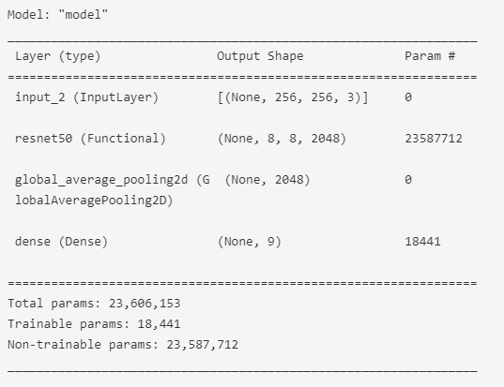
Initial Model - Transfer Learning only
ResNet50 (default)
Learning Rate | 0.001 (default)
Optimisers | Adam
Loss function | Categorical Crossentropy
Metric | Categorical Accuracy

Slide 47
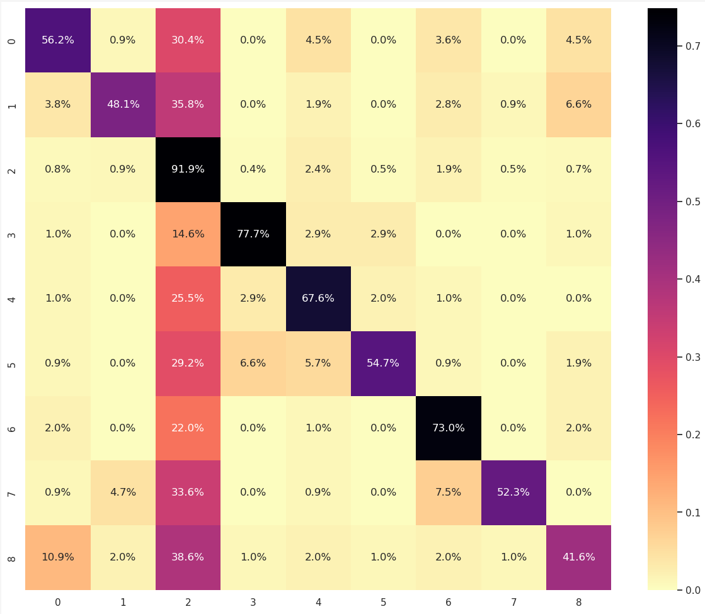
Initial Model - Transfer Learning only
Validation Set (Recall)
Train accuracy | 84.15%
Validation accuracy | 76.02%
Micro Recall | 492 TP / 837 (TP+FN)= 58.78%
Note: Class 2 is Negative Class

Slide 48
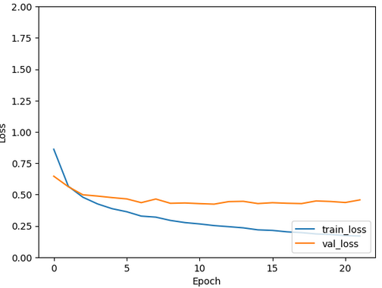
Initial Model - Transfer Learning only
Issue
Recall is low after training -> weeds are being missed by the model
Model was not able to converge to a good value as the features of weeds are not as distinct from each other.
Still have some room to train but risk overfitting -------->
What can we try?
Increase complexity of model by introducing a hidden convolution layer
Loss Curve

Slide 49
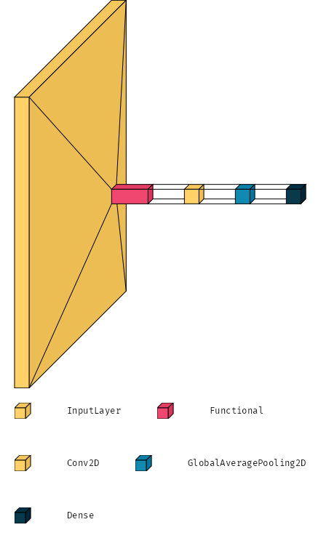
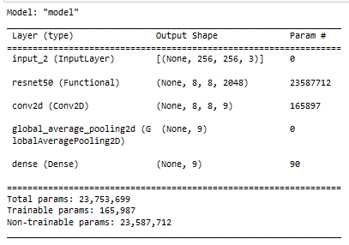
2nd Model - Transfer Learning + Small Convolution Layer

Slide 50
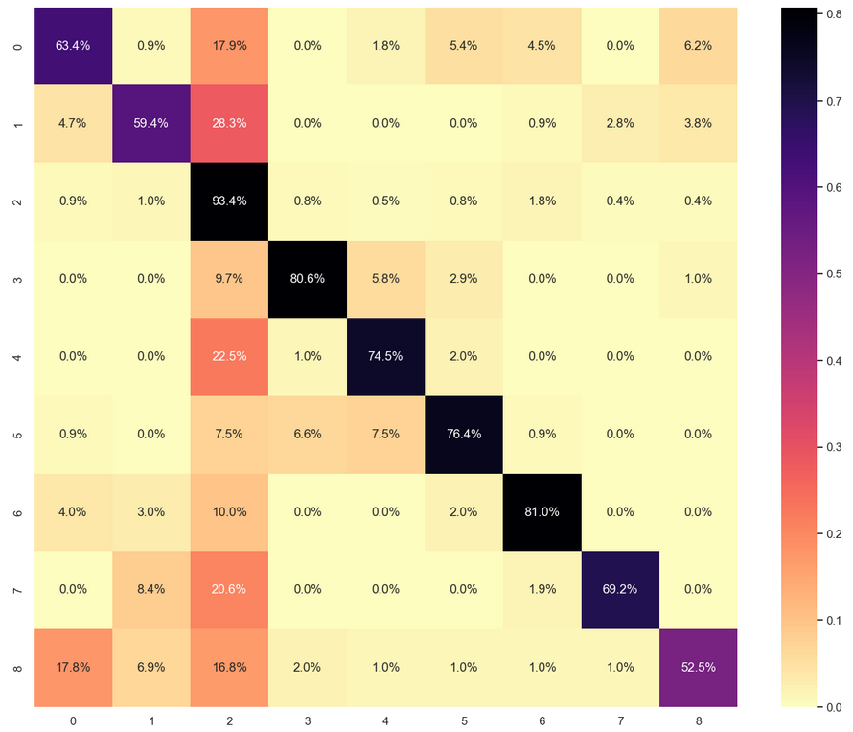
2nd Model - Transfer Learning + Small Convolution Layer
Validation Set (Recall)
Train accuracy | 94.48%
Validation accuracy | 81.97%
Micro Recall | 582 TP / 837 (TP+FN)= 69.53%
Note: Class 2 is Negative Class

Slide 51
Results
Recall: 58.78%
Recall: 69.53%
Increase in Recall -> model able to capture more weeds and categorize them correctly!

Slide 52
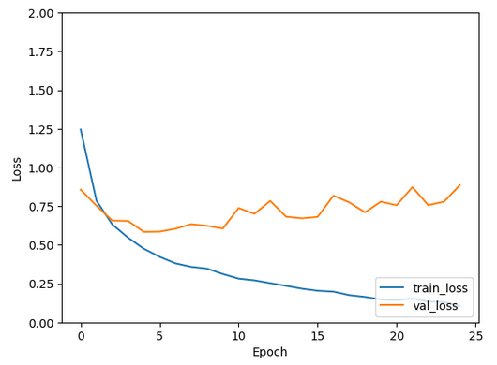
2nd Model - Transfer Learning + Small Convolution
Issue
Recall is still low after training -> weeds are being missed by the model
Model performed better as there are more parameters to change
Model is likely suffering from high variance (~94%)
What can we try?
Increase size of hidden layers
Loss Curve

Slide 53
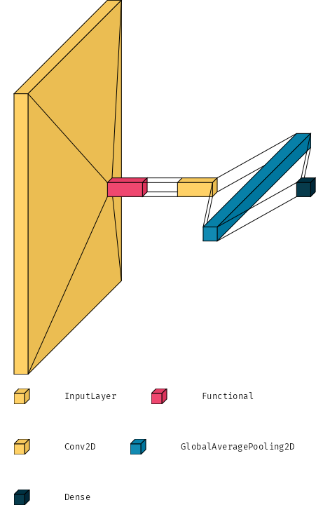
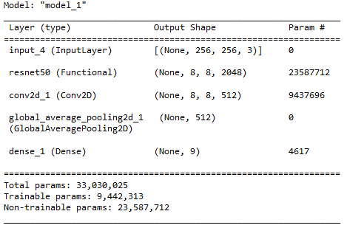
3rd Model - Transfer Learning + Larger Convolution Layer

Slide 54

3rd Model - Transfer Learning + Larger Convolution Layer
Validation Set (Recall)
Train accuracy | 99.01%
Validation accuracy | 86.89%
Micro Recall | 681 TP / 837 (TP+FN)= 81.36%
Note: Class 2 is Negative Class

Slide 55
Results
Recall: 69.53%
Recall: 81.36%
Increase in Recall -> Notice the line at column index 2 has become overall lighter in color!

Slide 56
3rd Model - Transfer Learning + Larger Convolution Layer
Issue
Model is likely suffering from high variance soon: what can we do? (~99%)
What can we try?
Increase complexity of feature present

Slide 57




Exploring apply 3 filters
Original Image
Histogram equalized
HSV masking
Group Gabor Filter
What this achieves:
Normalize parts where it is shady (effectively removing shadows)
Remove a lot of noise by keeping only relevant sections of the image
Simplify the features, pass to model as a “backup” to refer to

Slide 58


4th model - 3rd Model + 3 Filters applied

Slide 59

4th model - 3rd Model + 3 Filters applied
Validation Set (Recall)
Train accuracy | 98.59%
Validation accuracy | 88.09%
Micro Recall | 675 TP / 837 (TP+FN)= 80.65%
Note: Class 2 is Negative Class

Slide 60
Results
Recall: 81.36%
Recall: 80.65%
No visible improvement for validation dataset. In fact, recall has dropped! Notice Class 5 (prickly acacia) has more false positives and negatives!

Slide 61






Class Activation Map of conv2D layer
Positive class contributed to activation map
Activation region overlaps with true label?
Gabor Filter contributed to activation map
Original
Predicted: Parthenium
True Label: Prickly Acacia

Slide 62



Class Activation Map of conv2D layer
Perhaps whites spots mistaken as white flowers of parthenium?
Spot on!
Original
Predicted: Parthenium
True Label: Prickly Acacia

Slide 63
4th model - 3rd Model + 3 Filters applied
Issue
Features were suboptimal and confuses the model more
Model not complex enough
What can we try?
Increase complexity of feature present
Include other data that might help model

Slide 64
What we did
4th model - 3rd Model + 3 Filters applied
Increase hidden layer size
Modify input data
Exponentially more parameters to tune
Longer to converge, is our dataset that complex?
Data augmentation
Rotate
Flip
Include other transformation?
Can always come back to explore with more data as well!

Slide 65



5th model - 4th Model + Histogram Equalized + Rotate & Flip x4
+
Note: rotate and flip doubles as an upsampling method and thus only applied to non-negative datapoints

Slide 66

5th model - 4th Model + Histogram Equalized + Rotate & Flip x4
Validation Set (Recall)
Train accuracy | 97.50%
Validation accuracy | 88.40*%
Micro Recall | 711 TP / 837 (TP+FN)= 84.95%
*augmented validation set
Note: Class 2 is Negative Class

Slide 67
Summary Transfer Learning
Models vs Performance (Macro Recall)
ResNet50 | 58.78 %
ResNet50 + Small conv | 69.53 %
ResNet50 + Bigger conv | 81.36 %
ResNet50 + Bigger conv + 3 cascaded filters (+data) | 80.65 %
ResNet50 + Bigger conv + 3 cascaded filters (+data) + Hist_eq (+data) + rotate & filp (+data) x4 | 84.95 %

Slide 68

Summary Transfer Learning
Models vs Performance (Macro Recall)
Base Model | 58.78 %
Base Model + Small conv | 69.53 %
Base Model + Bigger conv | 81.36 %
Base Model + Bigger conv + 3 cascaded filters (+data) | 80.65 %
Base Model + Bigger conv + 3 cascaded filters (+data) + Hist_eq (+data) + rotate & filp (+data) | 84.95 % <- selected

Slide 69
But what now? Can’t improve the model much more…
Assumption: Transfer learning has learnt the some of the best features for us as a starting point
What if we remove that assumption, and say that we need to build better features by ourselves (from scratch)?
Comparing CNN and Transfer Learning results, we see that
CNN models classifies positive cases quite accurately, but fails when there are no weeds (FP, which is less detrimental, but too much FP defeats the autonomy of system)
Transfer Learning models classifies negative cases more accurately, but tends to say a positive case is negative (FN, which is more detrimental)
Idea: Could we potentially ensemble the two models and make a better model?

Slide 70
Best Classifier
Able to classify the species accurately when presented with a weed image
Select by
Highest Recall (Micro) on Weed Species
Model | Recall
CNN - Simple | 66.78 %
CNN - 2 - Con | 75.38 %
CNN - 2 - Con - BNorm | 73.18 %
CNN - 2 - Con - BNorm - Aug | 92.23 %
CNN - 5 - Aug | 93.66 %
ResNet50 | 58.78 %
ResNet50 + Small conv | 69.53 %
ResNet50 + Bigger conv | 81.36 %
ResNet50 + Bigger conv + 3 cascaded filters (+data) | 80.65 %
ResNet50 + Bigger conv + 3 cascaded filters (+data) + Hist_eq (+data) + rotate & flip (+data) x4 | 88.26 %

Slide 71
Best Negative Detector
Able to accurately detect the presence or absence of weeds
Select by
Good N-Recall
Recall on Negative Class
Good Validation Accuracy
To reduce high FP
Balanced combination of both
Model | N-Recall | Val Accuracy
CNN - Simple | 90.0 % | 78.88 %
CNN - 2 - Con | 95.7 % | 85.98 %
CNN - 2 - Con - BNorm | 91.4 % | 82.77 %
CNN - 2 - Con - BNorm - Aug | 61.9 % | 85.00 %
CNN - 5 - Aug | 65.7 % | 85.59 %
ResNet50 | 91.9 % | 76.02 %
ResNet50 + Small conv | 90.4 % | 81.97 %
ResNet50 + Bigger conv | 92.0 % | 86.89 %
ResNet50 + Bigger conv + 3 cascaded filters (+data) | 94.9 % | 88.09 %
ResNet50 + Bigger conv + 3 cascaded filters (+data) + Hist_eq (+data) + rotate & flip (+data) x4 | 89.0 % | 88.40 %

Slide 72
Ensemble
Idea
Combine a good Classifier and a good Detector in an ensemble
Use output probabilities ([9]) from the above models as inputs to ensemble
Final predictions are made by
Conditional predictions
Train a neural network to figure out the best balance

Slide 73

Ensemble-NN
Trainable parameters: 5,961

Slide 74

Ensemble - NN
% based Confusion matrix for Validation set
Results
Train Accuracy | 99.88 %
Val Accuracy | 90.84 %
Recall (Micro) | 87.21 %

Slide 75

Testing
Select the best model amongst all
Based on Val Accuracy (i.e.) Ensemble-NN
Results
Accuracy | 91.70 %
Recall (Micro) | 89.15 %

Slide 76
Future
Build more complex Transfer Learning models
We wanted to gain a better understanding of effects of image dataset on various models, hence we started off with relatively small models. Increase in additional hidden layer size from 9 to 512 showed an increase in performance
Try Generative Adversarial Networks
If we can fool the classifier with fabricated images, we might be able to train a better overall model with said fabricated images and get better performance

Slide 77
Thank you

